Slide 1
Data
BT 3041: Analysis and interpretation of Biological Data

Slide 2
Outline
Types of data
Data visualisation

Slide 3
Types of Data
Data Set is a collection of Data Objects
Data Object: also called
Record, point, vector, pattern, event, case, sample, observation, entity
Data object is represented by a set of Attributes
Attribute: is a property or a characteristic of an object

Slide 4
Types of attributes
Qualitative
Nominal: just a name.
eg. pincodes, IDs, eye color
Ordinal: information to order objects.
Eg. {good, better, best}
Quantitative
Numerical value exists
Eg. temperature, pH

Slide 5
Quantitative attributes
Discrete
Binary
Continuous

Slide 6
Characteristics of Data sets
Dimensionality
Curse of dimensionality
Dimensionality reduction
Sparsity
Only a small fraction of attributes are non-zero
Resolution
Converting continuous quantities to discrete ones

Slide 7
Types of data sets
Record Data
Graph/network Data
Ordered data
Spatial, image and multimedia data

Slide 8
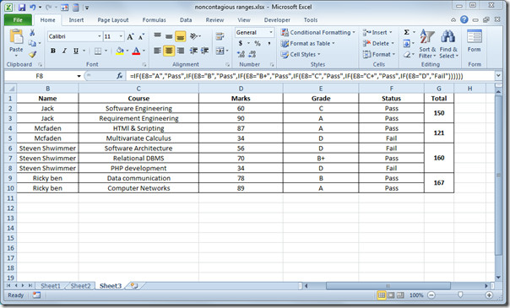
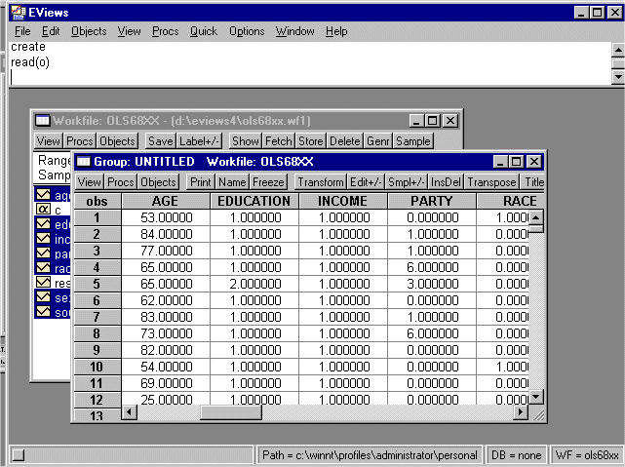
Record data: Same number of attributes
Data matrix
Document data
Market basket data

Slide 9
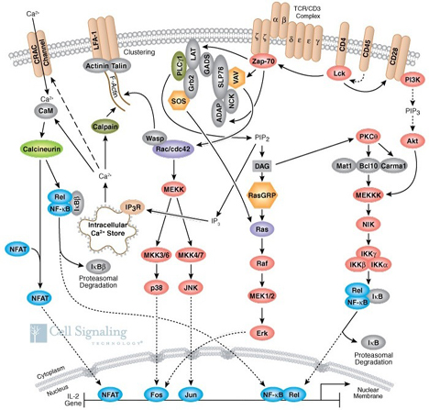
Graph/Network data
Examples:
Internet
Signaling networks
Molecular structures

Slide 10
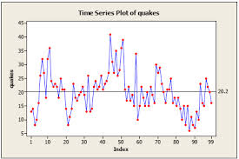

Ordered Data
Video data
Time series data
Molecular sequence data

Slide 11
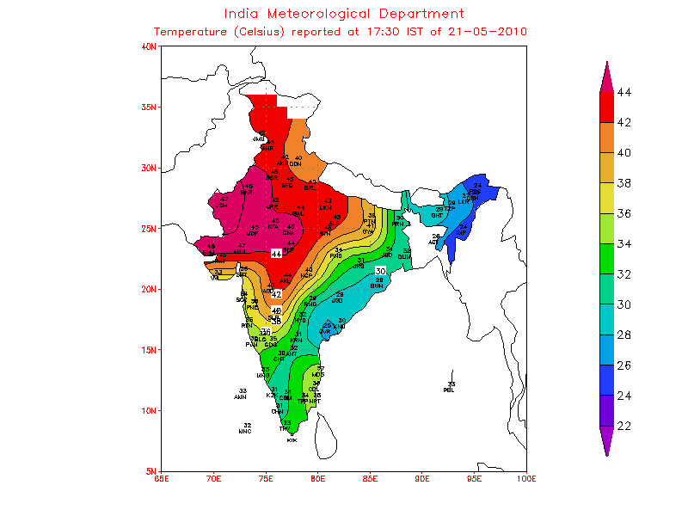
Spatial/image data
Examples:
Maps
Images
http://imgarcade.com/1/india-temperature-map/

Slide 12
Basic Statistical Descriptions of Data
Motivation
To better understand the data: central tendency and spread
Data dispersion characteristics
median, max, min, quantiles, outliers, variance, etc.
(Hans, Kamber, Pei 2013)
Notes:
Note to self (MK): last part of slide does not clearly match slides that follow
Introduction slides:
In the current version, we only talk about numeric data. Can we add some materials about non-numeric data.
- text statistics, TF/IDF
- visualization of text statistics such as word cloud
- distribution of Internet (IN, SCC, OUT, …)
- visualization of social relationship (e.g., http://renlifang.msra.cn/)

Slide 13
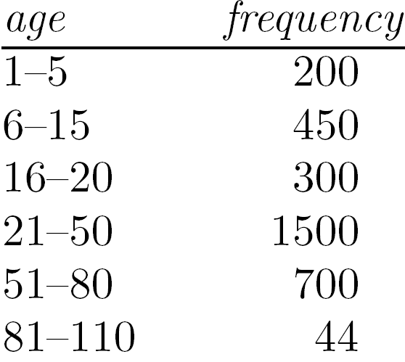
Measuring the Central Tendency
Mean (algebraic measure) (sample vs. population):
Note: n is sample size and N is population size.
Weighted arithmetic mean:
Trimmed mean: chopping extreme values
Median:
Middle value if odd number of values, or average of the middle two values otherwise
Mode
Value that occurs most frequently in the data
Unimodal, bimodal, trimodal
Median interval

Slide 14
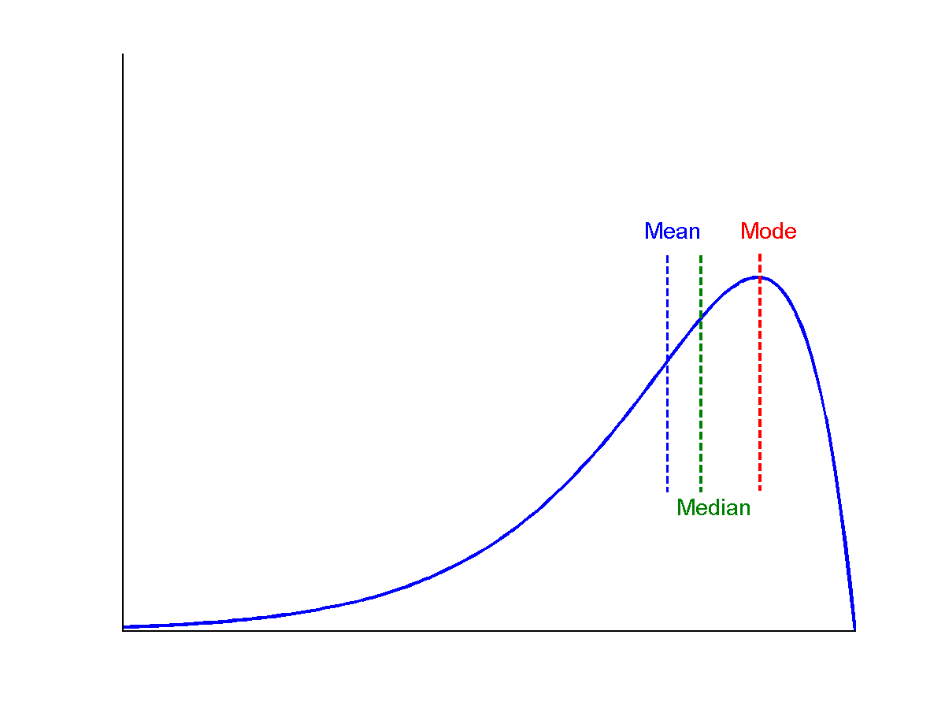
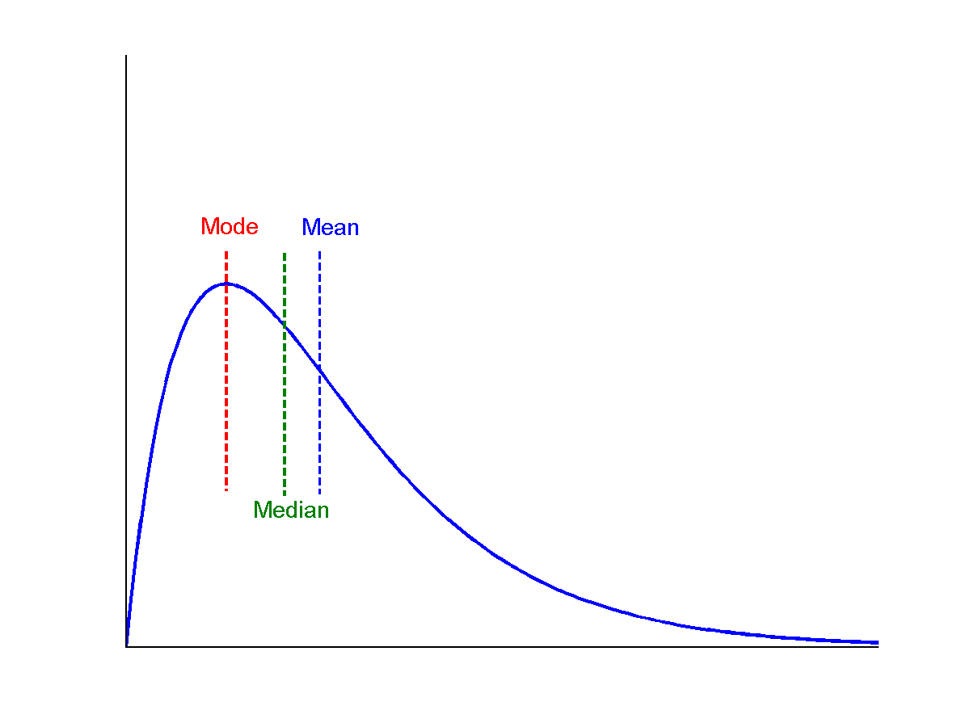
Symmetric vs. Skewed Data
Median, mean and mode of symmetric, positively and negatively skewed data
symmetric
positively skewed
negatively skewed

Slide 15
Measuring the Dispersion of Data
Quartiles, outliers and boxplots
Quartiles:
Q₁ (25th percentile): The first quartile (Q₁) is defined as the middle number between the smallest number and the median of the data set.
The second quartile (Q₂) is the median of the data.
Q₃ (75th percentile): The third quartile (Q₃) is the middle value between the median and the highest value of the data set.
Inter-quartile range: IQR = Q₃ – Q₁
Five number summary: min, Q₁, median, Q₃, max

Slide 16
Boxplot
Boxplot: ends of the box are the quartiles; median is marked; add whiskers, and plot outliers individually
Outlier: usually, a value higher/lower than 1.5 x IQR

Slide 17
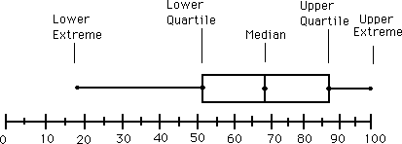
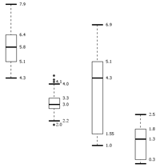
Boxplot Analysis
Five-number summary of a distribution
Minimum, Q1, Median, Q3, Maximum
Boxplot
Data is represented with a box
The ends of the box are at the first and third quartiles, i.e., the height of the box is IQR
The median is marked by a line within the box
Whiskers: two lines outside the box extended to Minimum and Maximum
Outliers: points beyond a specified outlier threshold, plotted individually
Notes:
Redraw the boxplot! Yes, we need a more real boxplot graph!

Slide 18
Properties of Normal Distribution Curve
The normal (distribution) curve
From μ–σ to μ+σ: contains about 68% of the measurements (μ: mean, σ: standard deviation)
From μ–2σ to μ+2σ: contains about 95% of it
From μ–3σ to μ+3σ: contains about 99.7% of it

Slide 19
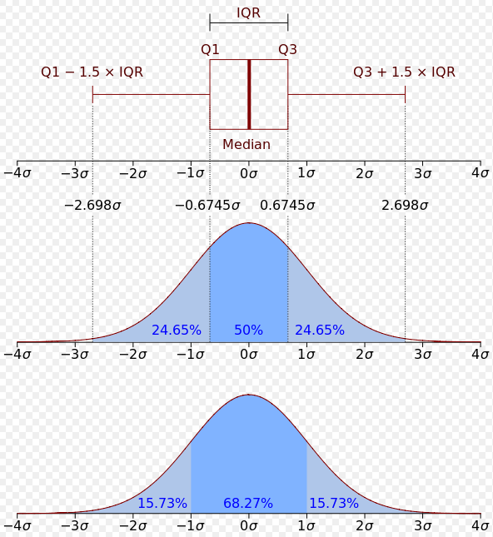
Boxplot for normal distribution

Slide 20
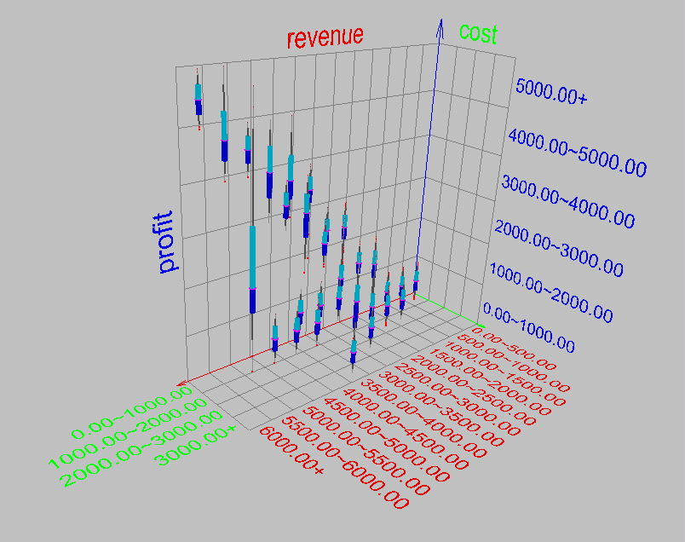
Visualization of Data Dispersion: 3-D Boxplots

Slide 21
Variance
Variance and standard deviation (sample: s, population: σ)
Variance: (algebraic, scalable computation)
Standard deviation σ is the square root of variance or σ²

Slide 22
Graphic Displays of Basic Statistical Descriptions
Boxplot: graphic display of five-number summary
Histogram: x-axis are values, y-axis repres. frequencies
Quantile plot: each value x_{i} is paired with f_{i} indicating that approximately 100 f_{i} % of data are ≤ x_{i}
Scatter plot: each pair of values is a pair of coordinates and plotted as points in the plane
Notes:
JH: Maybe we can remove Loess curve

Slide 23
Histogram Analysis
Histogram: Graph display of tabulated frequencies, shown as bars
It shows what proportion of cases fall into each of several categories
Differs from a bar chart in that it is the area of the bar that denotes the value, not the height as in bar charts, a crucial distinction when the categories are not of uniform width
The categories are usually specified as non-overlapping intervals of some variable. The categories (bars) must be adjacent
Notes:
JH: A better and BASIC histogram figure --- because this one overlaps with a later one!

Slide 24
Histograms Often Tell More than Boxplots
The two histograms shown in the left may have the same boxplot representation
The same values for: min, Q1, median, Q3, max
But they have rather different data distributions

Slide 25
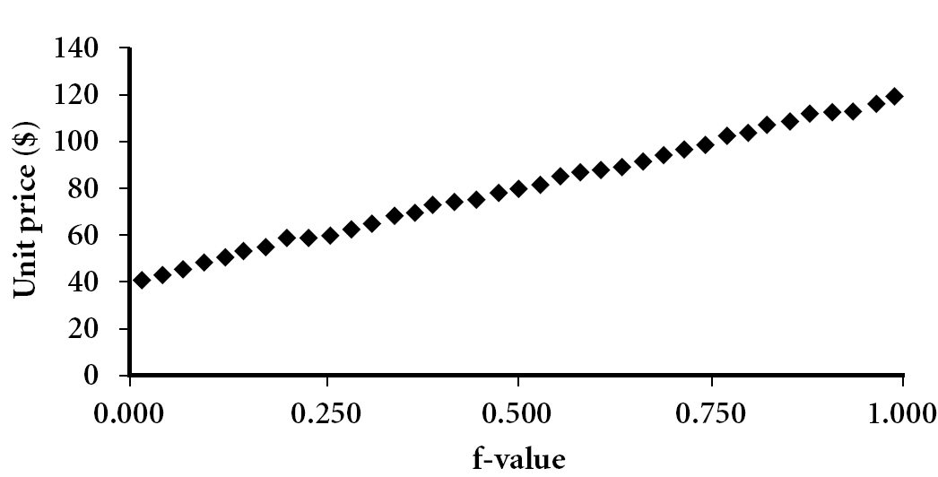
Quantile Plot
Displays all of the data (allowing the user to assess both the overall behavior and unusual occurrences)
Plots quantile information
For a data x_{i} data sorted in increasing order, f_{i} indicates that approximately 100 f_{i}% of the data are below or equal to the value x_{i}

Slide 26
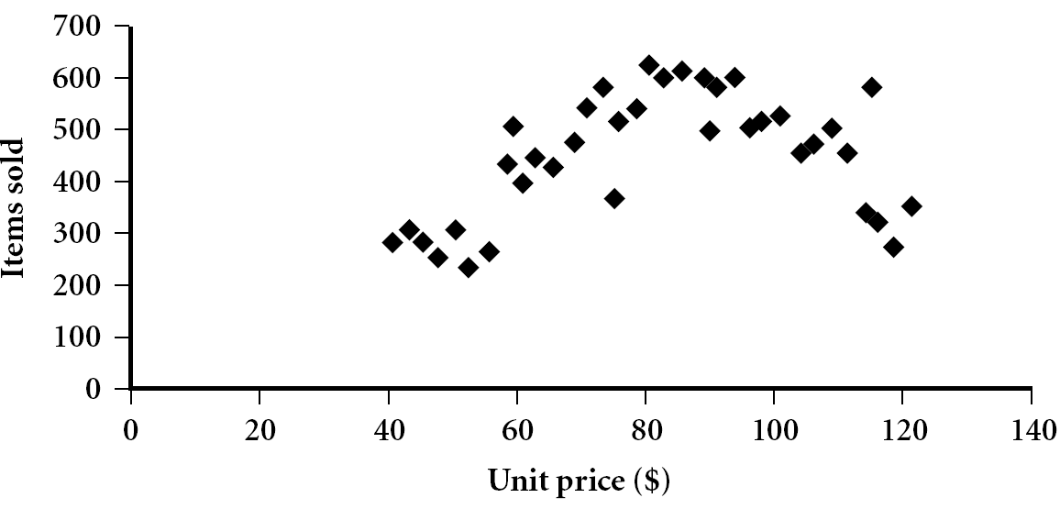
Scatter plot
Provides a first look at bivariate data to see clusters of points, outliers, etc
Each pair of values is treated as a pair of coordinates and plotted as points in the plane
Notes:
Need a better and more MEANINGFUL scatter plot! -JH

Slide 27

Data Visualization

Slide 28
Data Visualization
Why data visualization?
Gain insight into an information space by mapping data onto graphical primitives
Provide qualitative overview of large data sets
Search for patterns, trends, structure, irregularities, relationships among data
Help find interesting regions and suitable parameters for further quantitative analysis
Notes:
CC (conference call) 08.11.02: Need to check Wiki to update references.

Slide 29
Visualizing in low dimensions

Slide 30
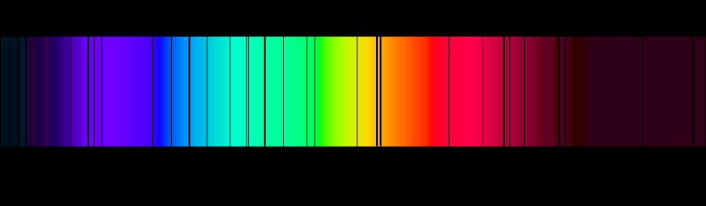
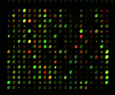
Pixel-Oriented Visualization Techniques
1D
2D
Solar spectrum
Microarray data
30
Notes:
30
CC (conference call) 08.11.02: Need to check Wiki to update references.

Slide 31
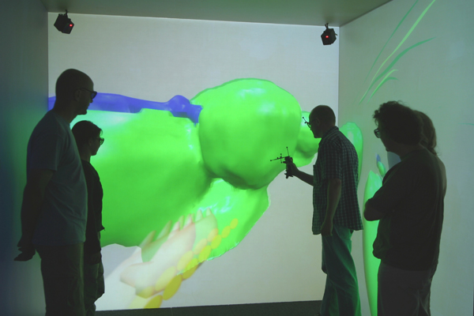
3D visualization
Interactive visualization of three-dimensional biological models in a CAVE.
http://www.jvrb.org/past-issues/6.2009/2257

Slide 32
Histogram
Ex: Iris data
5 kinds of Iris flowers
4 attributes: petal length/width, sepal length/width
50 samples per each flower type

Slide 33
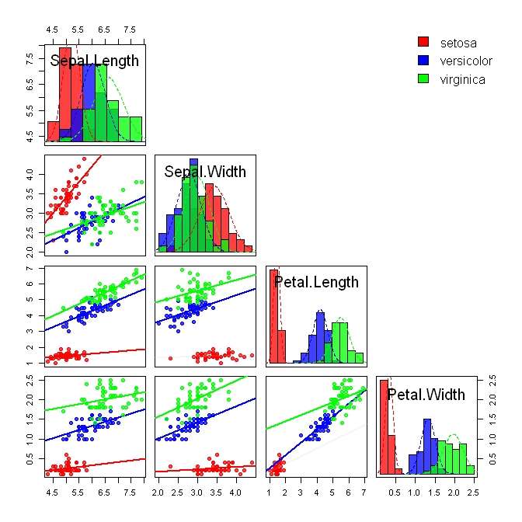
Iris data: histograms of individual attributes

Slide 34
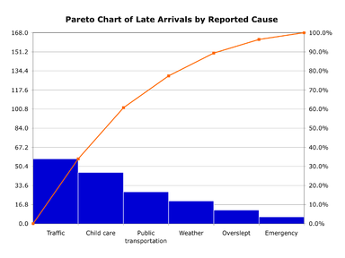
Pareto histogram
Frequencies are sorted

Slide 35
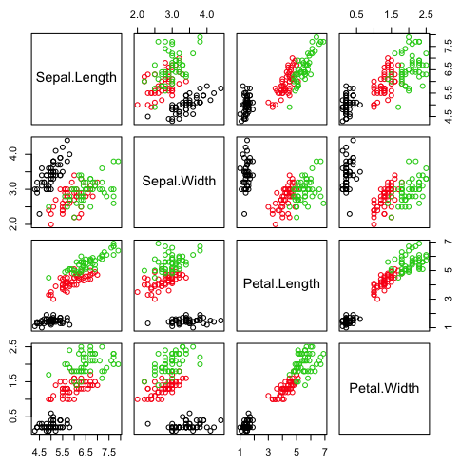
Scatter plots

Slide 36
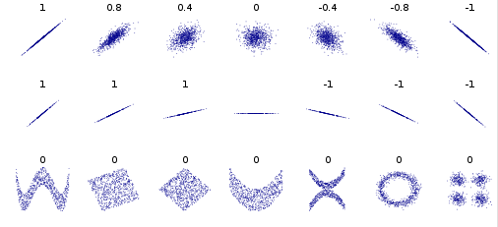
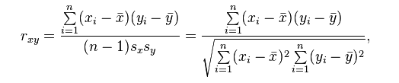
Correlation from scatter plots

Slide 37
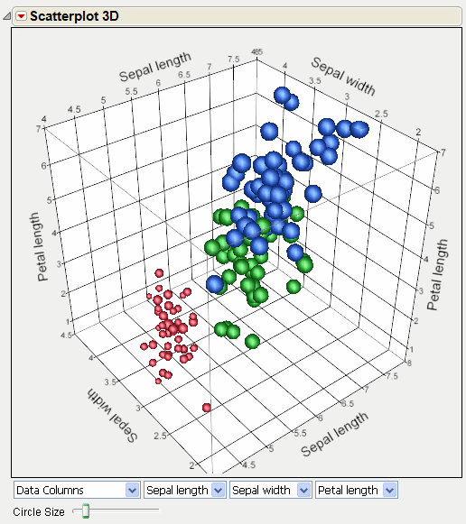
Scatter plot in 3D

Slide 38
Visualizing spatio-temporal data

Slide 39
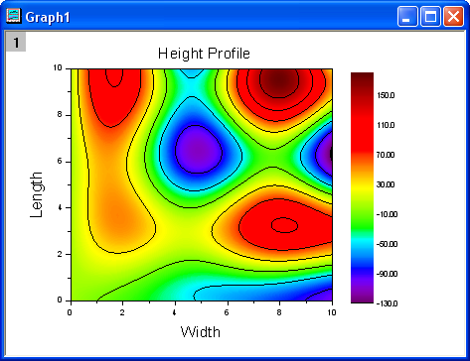
Contour plot

Slide 40
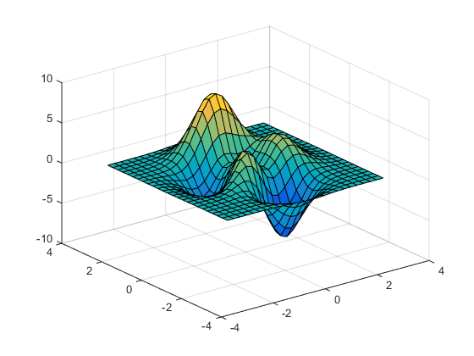
Surface Plot

Slide 41
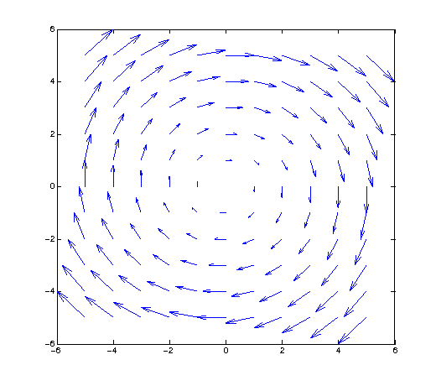
Vector field plots
2D
A vector is depicted at every point

Slide 42
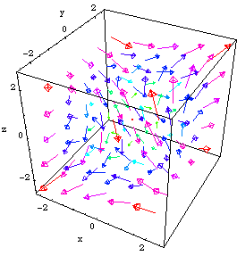
Vector field plots
3D
A vector is depicted at every point

Slide 43
Visualizing in high dimensions

Slide 44
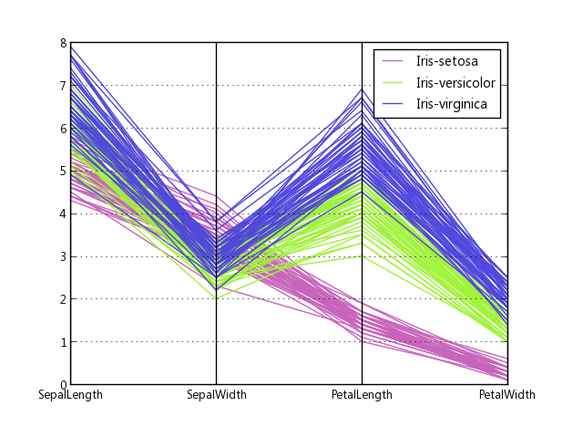
Parallel Coordinates plot

Slide 45
Star Coordinates
Sw – sepal width
Sl – sepal length
Pl – petal length
Pw – petal width
sw
pl
sl
pw

Slide 46
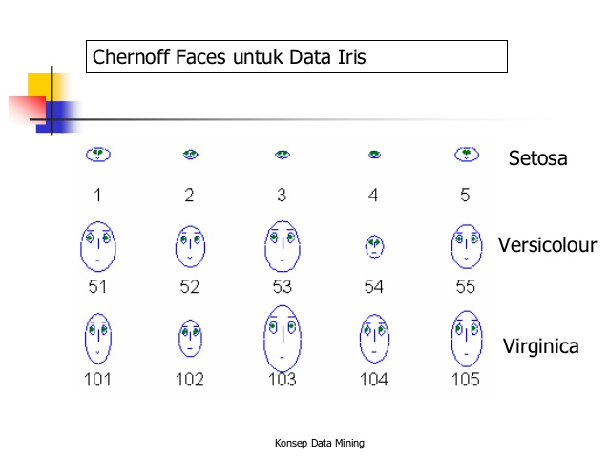
Chernoff faces
SL = size of face
SW = forehead/jaw ratio
PL = shape of forehead
PW = shape of jaw

Slide 47
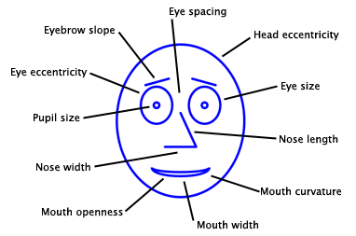
A more intricate use of Chernoff faces

Slide 48
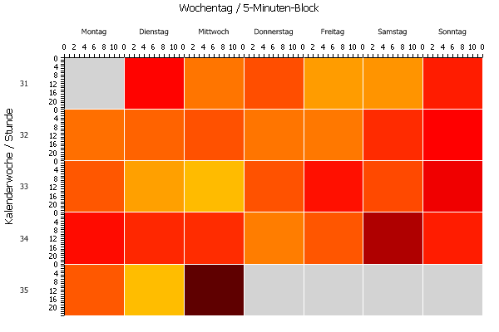
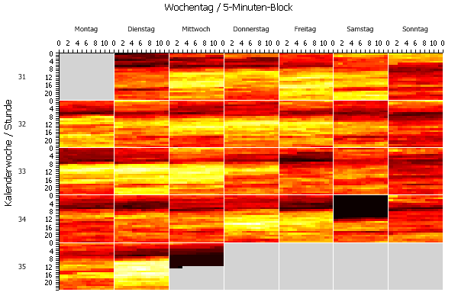
Multiscale visualization
(Shimabukuro et al 2004)

Slide 49
Circle segment display

Slide 50
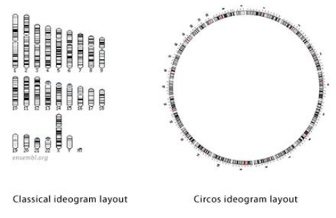
CIRCOS
http://jura.wi.mit.edu/bio/education/hot_topics/Circos/Circos.pdf

Slide 51
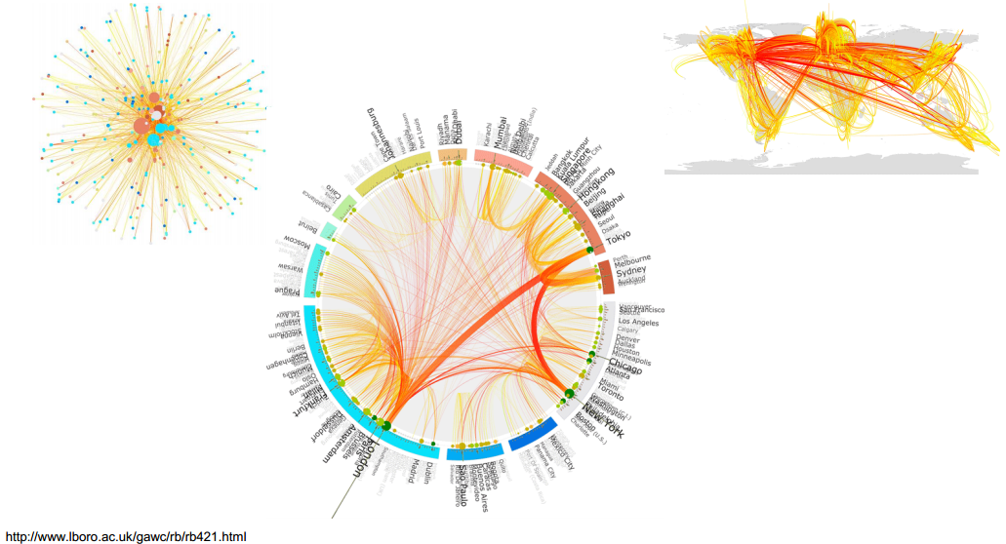

Slide 52
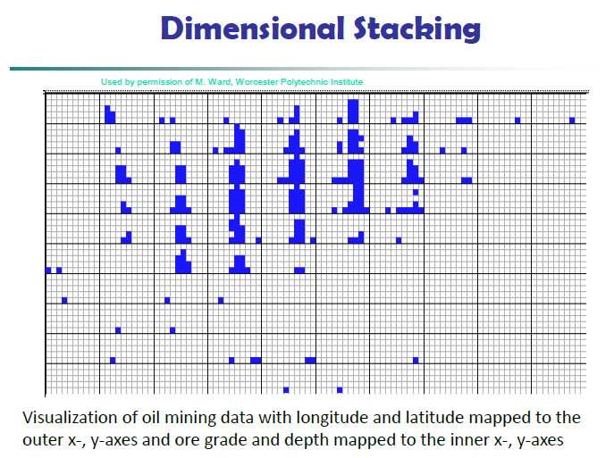

Slide 53
Cone trees
Display hierarchical data as cones
Root node = apex; children = around the base
Nodes are transparent so that you see the nodes in the background
Cones lower in the hierarchy are progressively smaller
If you click on a node, the node and the entire path from the root node are highlighted

Slide 54
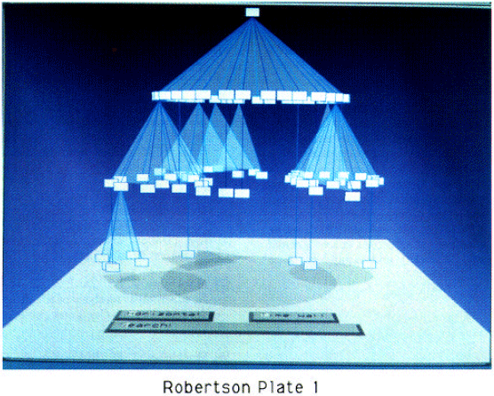
A Cone Tree

Slide 55
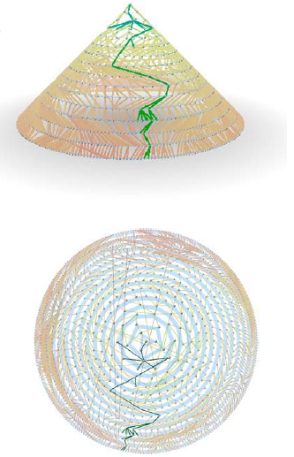
Another cone tree!

